Slide 1

DIGITAL ID HACKATHON
Team kabwe Zambia
Team members
Moses kabwe
Louis mubanga
Reagan Chalwe
Euphresia Namangolwa Muyangwa
Ngenda Katungu

Slide 2
We are Team kabwe from Zambia affiliated with ZCAS University. Our project is focused on securing fair loans for farmers through verifiable digital identities and empowering smallholder farmers with blockchain-based land ownership IDs

Slide 3
Problem background
Industry: Agriculture & financial inclusion (smallholder farmers in southern Africa).
Context & Setting
Smallholder farmers in Southern Africa form the backbone of regional food security and livelihoods, yet they remain trapped in a cycle of financial exclusion and vulnerability.
Current Pain Points
No Trusted Identity System → Farmers are "invisible" to banks/government Manual Processes → Paper-based records delay aid and loans for months
The absence of verifiable digital identities and land ownership records locks farmers out of:
Government subsidies 🏛️
Bank loans & insurance 🏦
Fair market access 📊

Slide 4
Problem Statement & Significance
Currently, the lack of verifiable digital identities and land records for smallholder farmers in Southern Africa prevents access to subsidies, loans, and insurance. This exclusion perpetuates poverty, enables fraud, and undermines climate resilience, threatening regional food security.
Why It Matters
Social/Economic Impact:
Affects over 40 million smallholder farmers in Southern Africa (World Bank, 2023).
Fraud drains $300M annually from agricultural subsidies in the region (FAO, 2022).
Equity Implications:
Women farmers (60% of the workforce) face double exclusion due to discriminatory land laws.
Environmental Risks:
Without insurance/tools, farmers cannot adapt to droughts/floods, and worsening food shortages.

Slide 5
Solution Overview
Proposed Solution
Our solution, the SADC Digital Farmer ID, leverages biometric authentication and blockchain technology to solve financial exclusion and fraud in Southern African agriculture.
We empower farmers with a secure digital identity that unlocks subsidies, loans, and agritech tools—all while protecting their data sovereignty."
How it works
Biometric Digital IDs create unique, unforgeable identities for farmers
Blockchain records tie identities to land GPS coordinates, exposing ghost beneficiaries
Digital profiles include farming history, enabling parametric insurance (automatic payouts for droughts).
API integrations connect farmers to e-commerce platforms and fair-price buyers.

Slide 6
Differentiation & Key Contributions
What makes us innovative
First SADC-wide ID linking biometrics to land + credit history → unlocks higher loan amounts.
USSD/SMS enrollment works without the internet, while the blockchain backend enables advanced features (e.g., smart contracts).
Registry auto-matches farmers to buyers based on crop type, location, and sustainability practices.
Existing Solutions | SADC Digital Farmer ID
Paper-based IDs (easily forged) | Biometric + blockchain (tamper-proof)
(banks/gov’ts don’t share data) | Interoperable APIs (connects all stakeholders)
Smartphone-dependent (excludes rural farmers) | USSD/SMS access (works on any phone)

Slide 7
Use of digital ID
Smart Ecosystem Access
For farmers a single ID unlocks: loans (via bank APIs), subsidies (gov’t portal integration), and marketplaces (e.g., agribusiness buyer platform),
Blockchain-Powered Verification
Farmer data is stored on a decentralized ledger (Hyperledger Fabric).
Banks/gov’t access permissioned nodes to verify identities in real-time.
Biometric Foundation
Core function: Every farmer receives a unique, biometric-based digital ID (fingerprint/iris scan) linked to their:
Personal profile (name, location)
Land ownership/usage rights
Farming history (crops, yields)

Slide 8
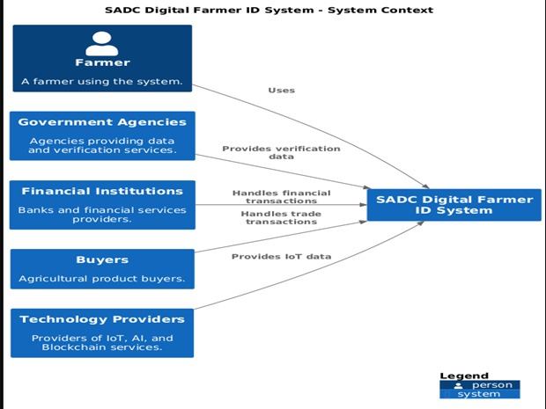
System Architecture (High-Level)
This visual shows how the SADC Digital Farmer ID System interacts with key stakeholders and what data/services are exchanged between them.

Slide 9
conclusion
The SADC Digital Farmer ID System represents a paradigm shift in how smallholder farmers access resources, markets, and technology. By integrating biometric authentication, blockchain verification, and AI-driven analytics, we address the root causes of financial exclusion, fraud, and climate vulnerability across Southern Africa

